Slide 1
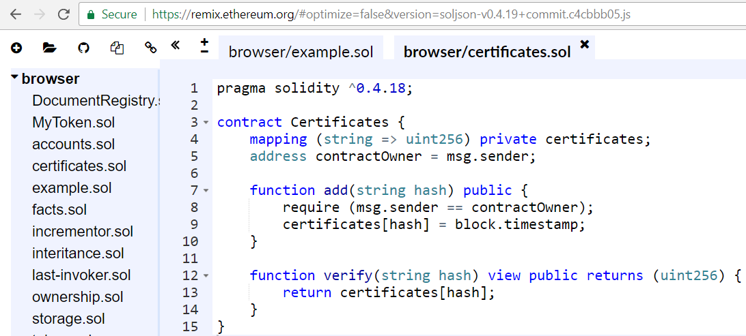

Solidity Advanced
Functions, Modifiers, Events, Contract Interactions, Error Handling, Libraries
Svetlin Nakov
Technical Trainer
Academy School of Blockchain
http://kingsland.academy

Slide 2




Table of Contents
Functions
Events
Units
Special Variables
Error Handling
Killing Contract
Solidity and Assembly
Libraries

Slide 3

Functions in Solidity
Visibility, Views, Pure Functions, Fallback

Slide 4

Functions in Solidity
Functions are the executable units of code within a contract
Once defined, can be invoked later (with some arguments):
pragma solidity ^0.4.16;
contract SimpleAuction {
function bid(uint bidPrice) public {
// function body …
}
}
bid(15000);

Slide 5
Visibility: Public and External
Public (default)
Part of the contract interface, can be called by anyone
For public state variables, an automatic getter function is generated
External
Functions designed to be called externally
From other contracts and by external transactions
An external function cannot be called internally
I.e. f() does not work, but this.f() works
uint256 public totalSupply;
function finalize() external { … }

Slide 6
Visibility: Internal and Private
uint256 internal totalSupply;
Internal
Accessed internally (i.e. from within the current contract or contracts deriving from it), without using “this”
Like "protected" in object-oriented languages
Private
Accessible in the contract only
Not accessible in the derived contracts
uint256 private totalSupply;

Slide 7
View (Constant) Functions
view == constant
Means "No changes, just read data"
contract ViewFunctions {
uint size = 5;
function getSize() public view returns (uint) {
return size;
}
function checkNonZero() public constant returns (bool) {
return size != 0;
}
}
constant is the same like view

Slide 8
Pure Functions
Pure functions depend on their parameters only
Promise not to read from or modify the contract state
contract PureFunctions {
function ethToWei(uint eth) pure returns (uint) {
return eth * 1000000000000000000;
}
function calcTriangleArea(
int width, int height) pure returns (int) {
return width * height / 2;
}
}

Slide 9

Messages Sent to Contracts
user
Sign & send tx
EVM
Parse msg to
function call + arguments
Solidity code
fn1()
fn2()
fn3()
Send msg + value
contract
address
invoke a function
Persist transaction in the next block
Return results

Slide 10
The "Fallback" Function
The fallback function is invoked when no other function is matched
contract FallbackContract {
uint public x;
function() public { x++; }
}
contract Invoker {
function callFallback(FallbackContract f) public {
f.call(0xabcdef01);
// Results in f.x becoming == 1
}
}

Slide 11
Function Overloading is Supported
contract FunctionOverloadingExample {
function sum(uint a, uint b) public pure returns (uint) {
return a + b;
}
function sum(uint a, uint b, uint c) public pure
returns (uint) {
return a + b + c;
}
}

Slide 12
Named Arguments in Function Calls
contract NamedArguments {
function power(uint val, uint times)
public pure returns (uint) {
if (times == 0) return 1;
return val * power(val, times-1);
}
function powerOf2(uint n)
public pure returns (uint) {
return power({val: 2, times: n});
}
}
You can use the ** operator ☺
Named arguments

Slide 13
Constant State Variables
Constants are like in other languages, assigned only once
Assigned from an expression constant at compile time
contract Constants {
uint constant x = 32**22 + 8;
string constant text = "hello";
bytes32 constant myHash = keccak256(text);
function size() pure public returns (uint) {
return uint(myHash);
}
}

Slide 14
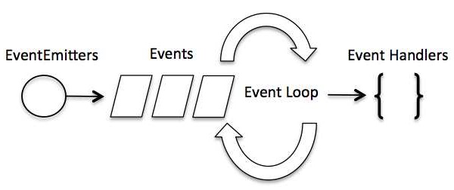
Events in Solidity
Logging That Something Was Happened

Slide 15
Ethereum Events
Events in EVM log structured data about something happened
These "logs" are permanently stored in the current transaction
DApp developers can "watch" for events through the Web3 API
contract EventsExample {
event Sum(address addr, unit a, uint b);
function sum(uint a, uint b) returns (uint) {
Sum(msg.sender, a, b); // Invoke the event to log its arguments
return a + b;
}
}

Slide 16
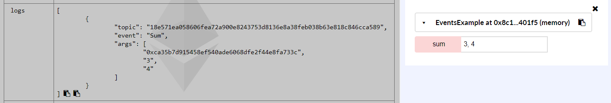
Events are Stored in the Transaction
Events are stored in the transaction logs in the Ethereum blocks
Emitting events costs gas, so be careful
Events are visible from the Remix IDE

Slide 17
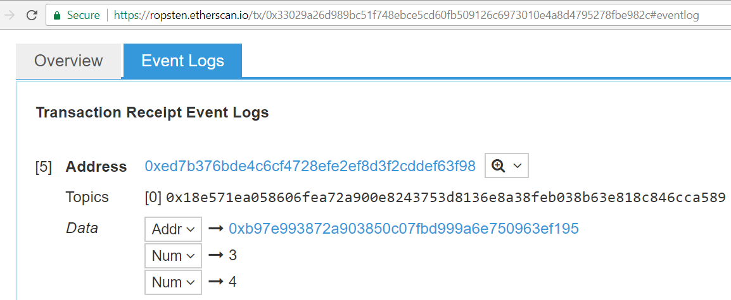
Events are Visible by Anyone
Events are part of transactions, visible at Etherscan:
https://ropsten.etherscan.io/tx/0x33029a26d989bc51f748ebce5cd60fb509126c6973010e4a8d4795278fbe982c#eventlog

Slide 18
Callbacks and Events
contract ClientReceipt {
event Deposit(
address indexed _from,
bytes32 indexed _id,
uint _value
);
function deposit(bytes32 _id) public payable {
Deposit(msg.sender, _id, msg.value);
}
}
The event can be can be traced from the Web3 API by filtering for "Deposit" to be called

Slide 19
Watching for Events from JavaScript
var abi = /* ABI as generated by the compiler */;
var clientReceipt =
web3.eth.contract(abi.at("0x1234…ab67" /* address */));
var event = clientReceipt.Deposit();
event.watch(function(error, result) {
if (!error)
console.log(result);
});
Watch for changes
The result will hold the event arguments

Slide 20
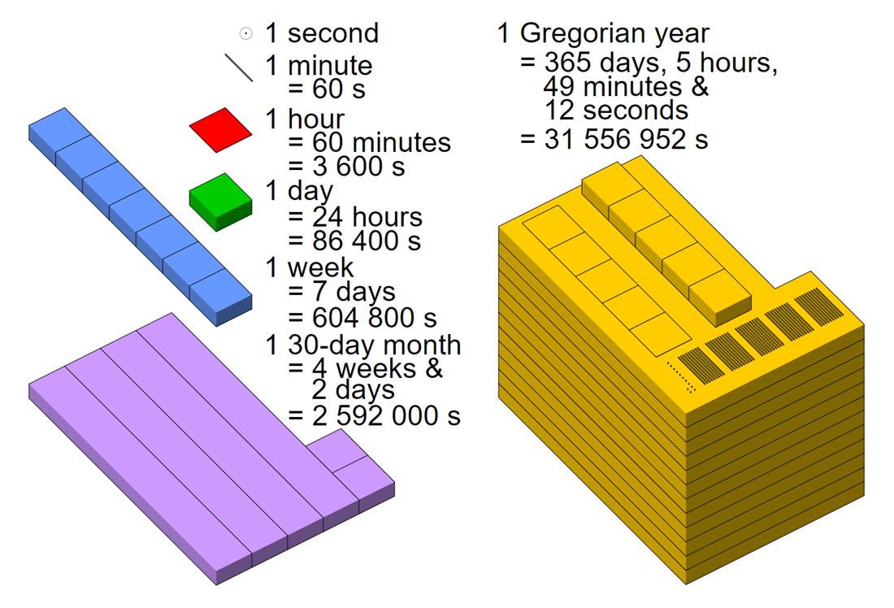
Time and Ether Units

Slide 21
Ether Units
A literal number can take a suffix of:
wei = 1 / 1 000 000 000 000 000 000 ETH
szabo = 1 / 1 000 000 ETH
finney = 1 / 1000 ETH
ether
https://etherconverter.online
function oneGwei() pure returns (uint) {
return 1000000000 wei;
}
function twoEthers() pure returns (uint) {
return 2 ether;
}

Slide 22
Time Units
1 == 1 seconds
1 minutes == 60 seconds
1 hours == 60 minutes
1 days == 24 hours
1 weeks == 7 days
1 years == 365 days
Suffixes like seconds, minutes, … after literal numbers convert between units of time
Seconds are the base unit
function f(uint start, uint daysAfter) public {
if (now >= start + daysAfter * 1 days) {
// …
}
}
function twoWeeks() pure returns (uint) {
return 2 weeks; }

Slide 23

Special Variables in Solidity
Block and Transaction Properties

Slide 24
Special Variables and Functions
Always exist in the global namespace and are mainly used to provide information about the blockchain
Transaction properties:
msg.data (bytes): complete calldata
msg.gas (uint): remaining gas
msg.sender (address): sender of the message (current call)
msg.value (uint): number of wei sent with the message
tx.gasprice (uint): gas price of the transaction
tx.origin (address): transaction sender (first caller in the chain)

Slide 25
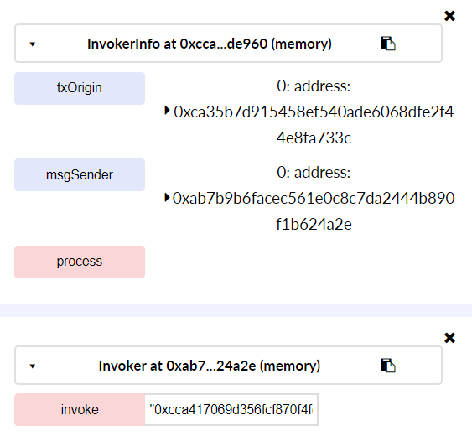
Message Sender vs. Transaction Origin
contract InvokerInfo {
address public msgSender;
address public txOrigin;
function process() {
msgSender = msg.sender;
txOrigin = tx.origin;
}
}
contract Invoker {
function invoke(InvokerInfo info) { info.process(); }
}

Slide 26
Special Variables and Functions
Block properties
block.coinbase (address): current block miner’s address
block.number (uint): current block number
now (uint): current block timestamp (alias for block.timestamp)
function blockCoinbase() view returns (address) {
return block.coinbase; }
function blockNumber() view returns (uint) {
return block.number; }
function blockTimeStamp() view returns (uint) {
return block.timestamp; }

Slide 27
Random Numbers in Solidity
There is no secure random generator in Solidity
Miners can manipulate the randomness (if they want to)!
Some apps use a insecure random, based on the last few blocks
Some partially predictable randomness can be taken from:
block.blockchash of the previous block
block.timestamp, block.coinbase, block.difficulty, block.number of the current block
Example: https://github.com/axiomzen/eth-random/blob/v1-candidate/contracts/Random.sol

Slide 28
Insecure Pseudo-Random – Example
contract InsecureRandomGenerator {
bytes32 public randseed;
function pseudoRandom(uint start, uint end)
returns (uint) {
randseed = keccak256(randseed, block.timestamp,
block.blockhash(block.number-1), block.coinbase,
block.difficulty, block.number);
uint range = end - start + 1;
uint randVal = start + uint256(randseed) % range;
return randVal;
}
}

Slide 29
Error Handling
Solidity uses state-reverting exceptions to handle errors
Such an exception will undo all changes made to the state in the current call (and all its sub-calls) and also flag an error to the caller
require(bool condition):
throws if the condition is not met – to be used for errors in inputs or external components
assert(bool condition):
throws if the condition is not met – to be used for internal errors
revert():
abort execution and revert state changes

Slide 30
Error Handling
When exceptions happen in a sub-call, they “bubble up” (i.e. exceptions are rethrown) automatically
Exceptions to this rule are “send” and the low-level functions ”call”, “delegatecall” and “callcode” – those return false in case of an exception instead of “bubbling up”
The low-level “call”, “delegatecall” and “callcode” will return success if the calling account is non-existent, as part of the design of EVM
Existence must be checked prior to calling if desired
Catching exceptions is not yet possible

Slide 31
Check Conditions with Require and Assert
contract Sharer {
function sendHalf(address addr) public payable
returns (uint balance) {
require(msg.value % 2 == 0);
uint balanceBeforeTransfer = this.balance;
addr.transfer(msg.value / 2);
// Since transfer throws an exception on failure and cannot call back here,
// there should be no way for us to still have half of the money
assert(this.balance == balanceBeforeTransfer - msg.value / 2);
return this.balance;
}
}
Only allow even numbers
Assert the transfer is successful

Slide 32

Transferring Ethers

Slide 33
Payable Constructor
Use payable constructor to send ETH at contract creation
contract Token1000 {
mapping(address => uint)
public balances;
function Token1000() payable {
balances[msg.sender] += 1000 * msg.value;
}
}

Slide 34
Payable Fallback
Contracts can receive ethers, by payable fallback function
In this example 1 ETH gives 1000 tokens in the sender's balance
contract Token1000 {
mapping(address => uint)
public balances;
function() payable {
balances[msg.sender] += 1000 * msg.value;
}
}
ETH sent to this contract will be handled by this fallback function
ETH sender
Amount sent

Slide 35
Difference Between Send and Transfer
Address types have two members for sending Wei
<address>.transfer(uint256 amount)
send given amount of Wei to Address, throws exception on failure
<address>.send(uint256 amount) returns (bool)
send given amount of Wei to Address, returns false on failure
msg.sender.transfer(1 ether);
if (msg.sender.send(1 ether)) {
MoneySentEvent(msg.sender, 1 ether, "success");
}

Slide 36
Automatic Bill Payer
contract BillPayer {
event MoneyReceived(address sender, uint amount);
event MoneyPaid(address recipient, uint amount);
function BillPayer() payable public {
MoneyReceived(msg.sender, msg.value);
}
function() payable public {
MoneyReceived(msg.sender, msg.value);
}
…
}

Slide 37
Automatic Bill Payer (2)
contract BillPayer {
…
function getBalance() public view returns (uint) {
return this.balance;
}
function payBill(uint amount) public payable {
// TODO: check the bill sender and amount before the payment!
msg.sender.transfer(amount);
MoneyPaid(msg.sender, amount);
}
}

Slide 38
Contract Kill
Killing contracts does not really clean up
If Ether is sent to removed contracts, the Ether will be forever lost
Contract disable
Make all functions to throw and impossible to using contract
All ether sent to the contract will be returned automatically
Executed at initialization Assigns the owner
contract Mortal {
address private owner;
function Mortal() { owner = msg.sender; }
function kill() {
require(msg.sender == owner);
suicide(owner);
}
}
Recover the funds on the contract

Slide 39
Contract Kill
The current contract, explicitly convertible to address
this(current contract’s type)
Destroy the current contract, sending its funds to the given address
selfdestruct(address recipient)
Alias to selfdestruct
suicide(address recipient)

Slide 40
Creating Contracts via "new"
A contract can create a new contract
Using the new keyword
The contract is persisted in the blockchain at certain address
The full code of the contract being created has to be known in advance
So recursive creation-dependencies are not possible
If the creation fails (due to out-of-stack, not enough balance or other problems), an exception is thrown

Slide 41
Creating Contracts via "new"
contract Example {
uint private val;
function Example(uint initVal) { val = initVal; }
function add(uint amount) { val += amount; }
function val() view returns (uint) { return val; }
}
contract User {
Example e = new Example(100); // Publish a new contract
function getExampleAddr() view returns (address) { return e; }
function getExampleVal() view returns (uint) { return e.val(); }
}

Slide 42
External Function Calls
When calling functions of other contracts
You can use .value() to send money and .gas() to limit the gas
contract InfoFeed {
function info() public payable returns (uint ret) { return 42; }
}
contract Consumer {
InfoFeed feed;
function setFeed(address addr) public { feed = InfoFeed(addr); }
function callFeed() public { feed.info.value(10).gas(800)(); }
}

Slide 43
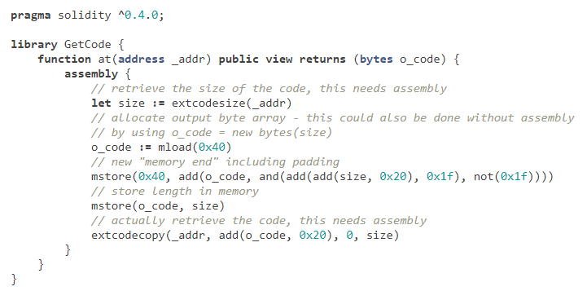
Inline Assembly
Solidity defines an assembly language can be used without Solidity
For advanced devs only!
Inline assembly inside Solidity source code
Language close to the one of the virtual machine
Example: https://github.com/Arachnid/solidity-stringutils/blob/master/strings.sol

Slide 44
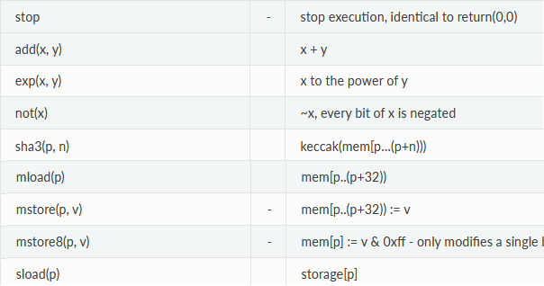
Opcodes
Opcodes encode machine instructions
Like any other assembler / virtual machine
mem[a...b) signifies the bytes of memory starting at position a up position p

Slide 45

Decompile Smart Contract
There is no decompiler for Solidity
Principle possible, but for example variable names will be lost
Bytecode can be decompiled to opcodes, e.g. here:
https://etherscan.io/opcode-tool
Contracts on the blockchain should have their original source code published if they are to be used by third parties

Slide 46
Libraries Hold Reusable Functions
SampleLib.sol
library SampleLib {
function calcSquare(int a) pure public
returns (int) {return a * a; }
}
UsingSampleLib.sol
import "./SampleLib.sol";
contract UsingSampleLib {
function calc(int a, int b) pure public returns (int) {
return SampleLib.calcSquare(a) + SampleLib.calcSquare(b);
}}

Slide 47


Libraries
Open Zeppelin offers many libraries for math (like SafeMath), crowdsale, mocks, payment, token and etc.
https://github.com/OpenZeppelin/zeppelin-solidity
Ethereum Package Management (EthPM) is the new Package Registry for Ethereum
http://truffleframework.com/docs/getting_started/packages-ethpm
https://github.com/ethpm

Slide 48

Summary
Functions – view, pure, fallback
Function overloading
Function modifiers – private, public, external
Events and callbacks
Creating contracts via new
Units ether units, time units
Globally available variables, e.g. block.timestamp, tx.origin
Special variables and functions
Libraries and EthPM

Slide 49
Solidity Advanced
http://www.kingsland.academy

Slide 50
Resources
Solidity: https://solidity.readthedocs.io
OpenZeppelin: https://github.com/OpenZeppelin/zeppelin-solidity
Ethereum Package Management (EthPM): https://www.ethpm.com/, https://github.com/ethpm/ethpm-spec

